Slide 1
Building Responsive Web Applications

Slide 2

Learning Check
Features of HTML
CSS
JavaScript and jQuery
Ajax

Slide 3
HTML5 page (Hypertext Markup Language)
Information to the browser to ensure web page is parsed the same way by different web browsers
<!DOCTYPE html>
<html lang="en">
<head>
<meta charset="UTF-8">
<meta name="viewport" content="width=device-width, initial-scale=1.0">
<title>Document</title>
</head>
<body>
</body>
</html>
<script src="qaScript.js"></script>
<link href="qaStyle.css" rel="stylesheet" />
Best display for the user’s viewport
Best in a separate files
In older documents (like HTML 4 or XHTML), the DOCTYPE refers to a DTD (Document Type Definition).
HTML 4.01: <!DOCTYPE HTML PUBLIC "-//W3C//DTD HTML 4.01 Transitional//EN" "http://www.w3.org/TR/html4/loose.dtd">
XHTML 1.1: <!DOCTYPE html PUBLIC "-//W3C//DTD XHTML 1.1//EN" "http://www.w3.org/TR/xhtml11/DTD/xhtml11.dtd">

Slide 4
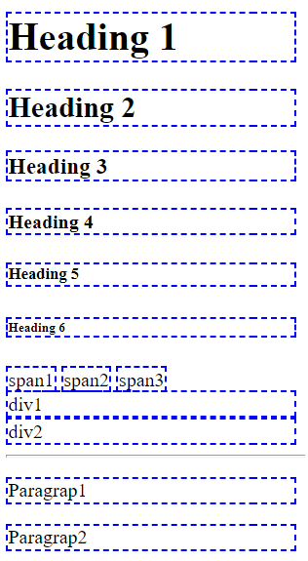
Revision: Tags for displaying data
Displaying text and
<span>
<h1,2,3,4,5,6>
Container
<div>
<p>
Breaks and lines
<hr>
<br>
Categories (see CSS display property)
Block
Inline
Block-inline
<h1>Heading 1</h1>
<h2>Heading 2</h2>
<h3>Heading 3</h3>
<h4>Heading 4</h4>
<h5>Heading 5</h5>
<h6>Heading 6</h6>
<span>span1</span>
<span>span2</span>
<span>span3</span>
<br />
<div>div1</div>
<div>div2</div>
<hr />
<p>Paragrap1</p>
<p>Paragrap2</p>
Demo

Slide 5

Revision: Basic formatting
<small>
<strong>
<b>
<i>
<u>
<sub> and <sup>
<del> <ins> and <mark> text
Water is H<sub>2</sub> if x is 5 then x<sup>2</sup> = 25</p>
<del>delete this</del>textThis text is <ins>insert</ins> here!Mark my <mark>word</mark>!</p>
Demo

Slide 6
More tags for displaying data
<abbr title="Hyper Text Markup Language">HTML</abbr>
<blockquote>
Example of blockquote<br />
Another line inside blockquote
</blockquote>
<div>text outside of blockquote</div>
<pre>
pre tag: These lines
Will display
as written
preserving spaces, tabs
and line breaks
<pre>
Demo

Slide 7

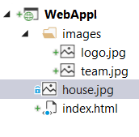
Relative and absolute path
Image in the same folder as the html page:
<img src="house.jpg" alt="Image of house" />
Image in the images sub-folder where the html page is located:
<img src="images/team.jpg" alt="QA team picture" />
Image in root folder:
<img src="/images/logo.jpg" alt="QA logo" />
Image from a URL:
<img src="http://qa.somee.com/html/slides/team.jpg" alt="QA team picture" />
Notes:
./ also refer to current folder
../ can be used to go back a folder and can be chained to go back multiple folders: ../../images/img.png

Slide 8
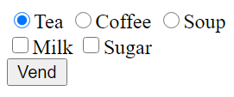
<form> Tag
Method (get/post)
action
<html>
<head>
</head>
<body>
<form method="get" action="serve.aspx" >
<div>
<input type="radio" name="drink" value="t" checked />Tea
<input type="radio" name="drink" value="c" />Coffee
<input type="radio" name="drink" value="s" />Soup
</div>
<div>
<input type="checkbox" name="chkMilk" value="y" />Milk
<input type="checkbox" name="chkSugar" value="y" />Sugar
</div>
<input type="submit" value="Vend" />
</form>
</body>
</html>
Demo

Slide 9
Controls for inputting and selecting data
<input type="___" />
Other attributes
min, max
autocomplete off/on
spellcheck true/false
maxlength
placeholder
disabled
text number email URL password date datetime time day month week submit reset File range
<input type="number" min="1 max="50" placeholder="type a number (1-50)" />
<input type="text" maxlength="10" placeholder="type password (1-10)" required/>
<input type="text" placeholder="type your name" spellcheck="false" autocomplete="off"/>
<button disabled>OK</button>
Demo

Slide 10
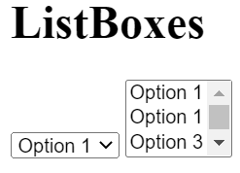
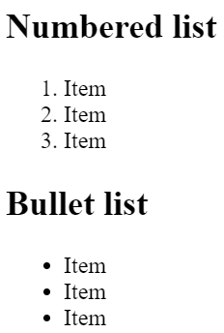
Basic lists for inputting and selecting data
Lists
ListBox and Dropdown Listbox:
select option
Ordered and unordered lists
<ul> <ol> <li>
Demo

Slide 11
Other forms of lists
Description list element
<dl>
<dt>Programming Courses</dt>
<dd>Java SE programming II</dd>
<dd>C# development</dd>
<dt>Web Development Fundamentals</dt>
<dd>Level 3 web application</dd>
<dd>Responsive web application</dd>
</dl>
<details>
<summary>details tag</summary>
<ol>
<li>Audio and video</a></li>
<li>Camera</li>
<li>Files</a></li>
<li>Geolocation</li>
</ol>
</details>
<input type="text" list="foodOptions" />
<datalist id="foodOptions">
<option value="Meat">
<option value="Vegetarian">
<option value="Semi-vegetarian">
<option value="Low-carbohydrate diet">
</datalist>
Demo
Notes:
Usage of description lists (dl) ensures that terms and their descriptions are semantically related
details specifies additional details that the user can open and close on demand with a collapsible area for list items
datalist is used to provide autocomplete feature, and is often used with an input tag so the users can narrow down the selections

Slide 12


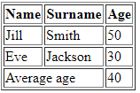
Table
For displaying tabular data or basic positioning other controls
<table border="1">
<tr>
<th>Name</th>
<th>Surname</th>
<th>Age</th>
</tr>
<tr>
<td>Jill</td>
<td>Smith</td>
<td>50</td>
</tr>
<tr>
<td>Eve</td>
<td>Jackson</td>
<td>94</td>
</tr>
</table>
<table border="1">
<thead>
<tr>
<th>Name</th>
<th>Surname</th>
<th>Age</th>
</tr>
</thead>
<tr>
<td>Jill</td>
<td>Smith</td>
<td>50</td>
</tr>
<tr>
<td>Eve</td>
<td>Jackson</td>
<td>30</td>
</tr>
<tfoot>
<tr>
<td>Average age</td>
<td>40</td>
<td></td>
</tr>
</tfoot>
</table>
<thead> and <tfoot> may be used for css
<tfoot>
<tr>
<td colspan="2">Average age</td>
<td>40</td>
</tr>
</tfoot>
Demo

Slide 13
CSS
Measurement units
DOM selection
Changing attributes
Positioning elements
Block, inline and inline-block
Enhancing the look using CSS3
Media queries

Slide 14
CSS - getting started
<html lang="en">
<head>
<title>Document</title>
<link rel="stylesheet" href="sheet1.css">
</head>
<body>
</body>
</html>
Importing CSS files
Measurement units:
px
em
vw
vh
vmax/vmin
rem
cm
Demo

Slide 15
CSS – Selectors - basic
*
.intro
#qa
.intro, #qa
h1
h1, p
h1:hover
p.qaClass
Demo
<style>
#div1 { background-color:red; }
.qaClass { background-color:green; }
p.qaClass { border: 3px dashed gray; }
div[company=qa] { background-color:blue; }
</style>
Demo
Demo
<body>
<div id="div1">id=div1</div>
<div class="qaClass">class=qaClass</div>
<p class="qaClass">class=qaClass</p>
<div company="qa">QA Training</div>
</body>

Slide 16
CSS –Selection by attribute
[id]
[company='QA']
[id$='ing'] id ends with ing
[id^=Q] id begins with Q
[id*=QA] id contains QA
input[type=text]:disabled {
background-color: lightgray;
}
input[placeholder *= 'C'] {
border: 3px groove red;
}
[company=QA]{
background-color: blue;
color:white;
font-weight:bold;
font-size:x-large;
width:30%;
text-align:center;
}
<p company="QA">QA Training</p>
<p>placeholder of ABC: <input type="text" placeholder="ABC" /></p>
<p>placeholder of AB: <input disabled type="text" placeholder="AB" /></p>
Demo

Slide 17
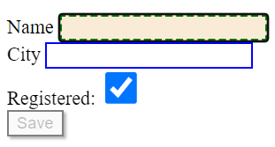
CSS – Selectors – by state
<body>
Name <input type="text" />
City <input type="text" />
Registered: <input type="checkbox" />
<button disabled>Save</button>
</body>
<style>
:checked {
height: 2em;
width: 2em;
}
:disabled {
border: 2px solid gray;
box-shadow: 2px 2px 2px;
}
:enabled {
border: 2px solid blue;
}
:focus {
border: 3px dashed green;
background-color: antiquewhite;
}
</style>
:checked
:disabled
:enabled
:focus
Demo

Slide 18
CSS – Selection by validation
input:in-range
input:out-of-range
input:invalid
input:valid
<html>
<head>
<style>
input:in-range {
border: 2px solid green;
}
input:out-of-range {
border: 2px solid red;
}
</style>
</head>
<body>
<input type="number" min="5" max="10" value="7">
</body>
</html>
Demo
Demo

Slide 19
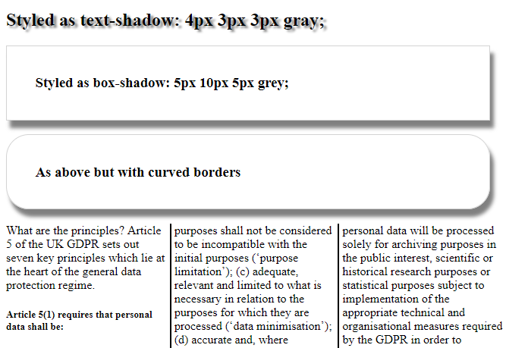
Enhancing the look!
Text and Box shadows
Curved borders
Multi-column display
Bullets
Menus
Tabs
Demo
Demo

Slide 20
CSS - positioning elements
Demo
Block, inline, inline-block
display
float, clear
position
static, absolute, sticky …
overflow
Demo
Demo

Slide 21
Bootstrap
Bootstrap is an open-source toolkit for developing HTML, CSS and JavaScript. Bootstrap makes building responsive web pages a lot easier and loads simple class names for most things in CSS, as well as providing default fonts, font weight and padding.
Getting Bootstrap onto your Web page is easy, according to the documentation. Each style sheet has its own HTML link ref. Simply copy and paste into the <head> section.
<html lang="en">
<head>
<meta charset="UTF-8">
<title>Bootstrap 5</title>
<!--This is the bootstrap CSS->
<link href="https://cdn.jsdelivr.net/npm/bootstrap@5.0.0-beta1/dist/css/bootstrap.min.css" rel="stylesheet" integrity="sha384- giJF6kkoqNQ00vy+HMDP7azOuL0xtbfIcaT9wjKHr8RbDVddVHyTfAAsrekwKmP1" crossorigin="anonymous“/>
</head>
<body>
<h1>My First Bootstrap Page</h1>
<!--This is the bootstrap JS-->
<script src="https://cdn.jsdelivr.net/npm/bootstrap@5.0.0-beta1/dist/js/bootstrap.bundle.min.js" integrity="sha384- ygbV9kiqUc6oa4msXn9868pTtWMgiQaeYH7/t7LECLbyPA2x65Kgf80OJFdroafW" crossorigin="anonymous"></script>
</body>
</html>

Slide 22
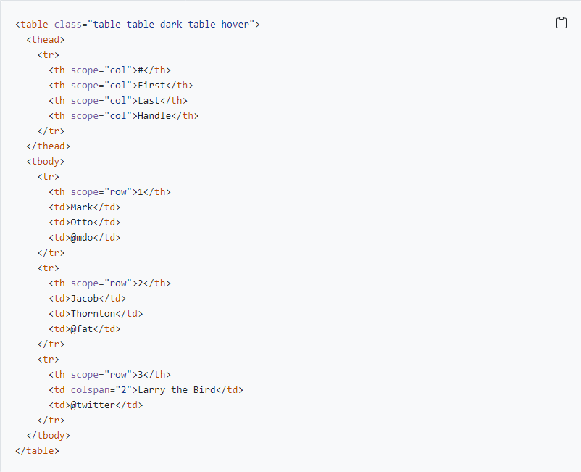
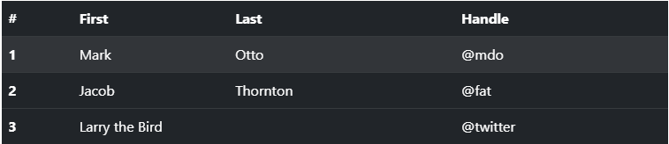
Bootstrap
Now you have the Bootstrap CSS and JS included in your HTML, you can visit: https://getbootstrap.com/docs/5.3/getting-started/introduction/ and start looking for pre-styled elements to use. For example, here’s an example of a bootstrap table. By using the correct attributes as described, and the appropriate bootstrap classes, you can get interactive, styled tables without writing any CSS yourself:

Slide 23
JavaScript
Revision of the language
DOM selection
DOM manipulation
Dynamic Events

Slide 24
Language basics – Selection and iteration
if (x > 5) {
console.log('x is bigger than 5');
}
else if (x == 5) {
console.log('x is equal to 5');
}
else {
console.log('x is less than 5');
}
let x = 5;
while (x > 0) {
console.log(x);
x--;
}
for (let i = 1; i < 10; i++) {
console.log(i);
}

Slide 25
forEach and Arrays
let names = ['Mike', 'Bob', 'Linda'];
names.forEach(n => {
console.log(n)
});
names.push('Sasha');
console.log(names);
['Mike', 'Bob', 'Linda', 'Sasha'];

Slide 26
Language basics – Methods
function add(a, b) {
return a + b;
}
3 ways to define a function
add = function (a, b) {
return a + b;
}
let result = add(1, 2);
console.log(result);
add = (a, b) => {
return a + b;
}

Slide 27
Selection of DOM elements
<div id="divInfo">.....</div>
<input type="radio" name="drink" />
<input type="radio" name="drink" />
<input type="radio" name="drink" />
<div class="redBorder">.....</div>
<div class="redBorder">.....</div>
let info = document.getElementById('divInfo');
let drinks = document.getElementsByName('drink');
let divs = document.getElementsByClassName('redBorder');
info.innerHTML = "QA"; drinks[0].checked = true;
divs[0].innerHTML = "QA";
Using querySelector
let info = document.querySelector('#divInfo');
let drinks = document.querySelectorAll('[name=drink]');
let divs = document.querySelectorAll('.redBorder');

Slide 28
Manipulating DOM elements – creating new elements
<ol id="students"></ol>
<script>
let ol = document.getElementById('students');
let names = ['Mike', 'Bob', 'Linda'];
names.forEach(name => {
let li = document.createElement('li');
li.innerHTML = name;
ol.appendChild(li);
});
</script>
Mike
Bob
Linda
Demo

Slide 29
JavaScript – Adding Events
<div id="divNames"></div>
<div id="lblName"></div>
<script>
let names = ['Jonathan', 'Christopher', 'Sean', 'Sasha', 'Kimberly', 'Lorenzo'];
let divNames = document.getElementById('divNames');
let lblName = document.getElementById('lblName');
let ol = document.createElement("ol");
divNames.appendChild(ol);
for (let i = 0; i < names.length; i++) {
let li = document.createElement("li");
li.innerHTML = names[i];
ol.appendChild(li);
li.addEventListener('click', (e) => {
if (e.target.href) {
lblName.innerHTML = e.target.href;
}
});
}
</script>
Demo

Slide 30
CSS – using JavaScript
let div1 = document.getElementById('div1');
div1.style.border = "1px solid red";
div1.className = "myStyle";
div1.classList.add("mystyle");
1
2
<style>
.mystyle {
width: 100%;
padding: 25px;
color: white;
}
</style>
3
var css = {
width: '150px',
height: '50px',
padding: '5px'
};
css.border = '2px dashed red';
Object.assign(div1.style, css);
4

Slide 31
Variable declaration – global, const
function scopeDemo() {
price = 100; // becomes global when the function is called
const VAT = 0.2; // local scope and value cannot change
// … some code
VAT = 0.15; uncaught TypeError: Assignment to constant variable.
}
scopeDemo();
console.log(price); // 100
console.log(VAT); Uncaught ReferenceError: VAT is not defined

Slide 32
Variable declaration – var, let
function scopeDemo() {
var p = 10; // function scope
let q = 2; // local scope (see for loop)
for (let i = 0; i < 5; i++) { // scope of i is within the for loop
var total = q * p + i; // following lines have access to total
}
console.log(total);
console.log(i); Uncaught ReferenceError: i is not defined
}
scopeDemo();
console.log(p); Uncaught ReferenceError: p is not defined
console.log(q); Uncaught ReferenceError: q is not defined
Recommendations
1- use const if value should not be change
2- use let to limit scope
3- do not use global variables!

Slide 33
OO in JavaScript
class Student {
constructor(name, age, stream) {
this.name = name;
this.age = age;
this.stream = stream;
}
getInfo() {
return `Name:${this.name}, Age:${this.age}, Stream:${this.stream}`;
}
}
let stu1 = new Student('Mike', 21, 'Software');
console.log(stu1.getInfo());
Name:Mike, Age:21, Stream:Software
stu1.company = 'QA';
console.log(stu1.company);
QA
Demo

Slide 34
JSON - stringify
let stu1 = new Student('Mike', 21, 'Software');
console.log(JSON.stringify(stu1));
{"name":"Mike","age":21,"stream":"Software"}
let stu2 = new Student('Linda', 19, 'Web');
let stu3 = new Student('Bob', 28, 'Testing');
let students = [stu1, stu2, stu3];
console.log(JSON.stringify(students));
[{"name":"Mike","age":21,"stream":"Software"},{"name":"Linda","age":19,"stream":"Web"},{"name":"Bob","age":28,"stream":"Testing"}]

Slide 35
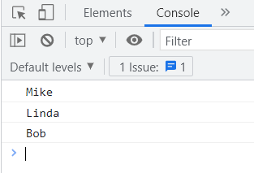
JSON - parse
let data = `[{"name":"Mike","age":21,"stream":"Software"},{"name":"Linda","age":19,"stream":"Web"},{"name":"Bob","age":28,"stream":"Testing"}]`;
let students = JSON.parse(data);
students.forEach(stu => console.log(stu.name));

Slide 36

Hope you enjoyed this pre course study

